Slide 1

Assignment Design in the Age of AI
The disruption AI brings to academic assessment isn't confined to a single field. What science instructors are grappling with today, colleagues in humanities, social sciences, and professional programs face equally. The challenge is universal — and it demands a collective, disciplined response.

Slide 2
If an assignment can be completed well by AI, was it measuring learning in the first place?
This is the central question reshaping how educators think about assessment design. It isn't a critique of any one instructor — it's a structural challenge that the entire academic community must confront together.

Slide 3

The Problem with Legacy Assignments, and an invitation to innovate
Most academic assignments were designed for a fundamentally different environment, one where students had to independently recall, synthesize, and produce knowledge. That environment no longer exists in the same form. Students now routinely use AI tools to generate ideas, structure arguments, locate information, and complete deliverables. Assignments that haven't been rethought are no longer measuring what we think they're measuring.

Slide 4
The Shift That's Already Happened
Before AI Integration
After AI Integration
Assignments assumed students would independently recall knowledge, draft from scratch, and rely on instructor feedback as their primary resource for improvement.
AI is already embedded in how students approach coursework. The real question is no longer whether students use these tools — it's what cognitive work we are actually asking them to do, and whether our assignments still demand it.

Slide 5



A Different Approach to Assessment
Rather than banning AI or ignoring it, a more effective path involves a deliberate three-step process: evaluate what you currently assign, identify precisely where AI changes or eliminates the cognitive task, and then redesign with meaningful learning at the center.
Evaluate
Identify
Redesign
Review existing assignments critically — what thinking do they require?
Pinpoint where AI now performs the task students were meant to do.
Rebuild assignments around judgment, process, and authentic thinking.

Slide 6
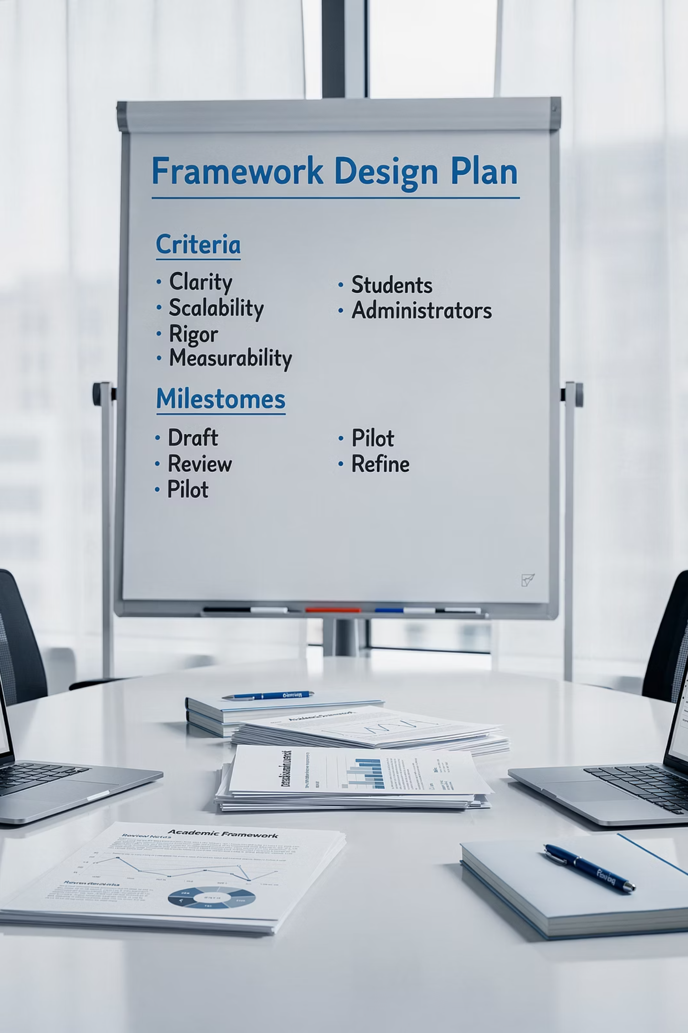
Introducing the Thering Framework
The Thering Framework offers seven criteria for evaluating and redesigning assignments in the AI era. It is built as a tool for reflection, not judgment designed to help instructors think more clearly about what their assignments actually demand of students. Crucially, the framework keeps students at the center: they remain the drivers of their own learning, with AI as a potential resource rather than a replacement for thinking.

Slide 7
Framework at a Glance
Seven interconnected criteria, aligned with SUNY priorities and AI-era learning expectations.
Outcomes
Cognitive Demand
Authenticity
Connected to clear learning goals
Students do the thinking
Real-world relevance and judgment
Equity
Process Visibility
AI Literacy
UDL-aligned, fair access
Learning journey made visible
Critical, ethical AI engagement
Teaching Methods
Active, inclusive, AI-aware instruction

Slide 8

Criterion 1: Alignment with Outcomes
Every assignment should be traceable to specific learning goals — not just course objectives, but the broader competencies students need to carry forward. In an AI-aware context, this means asking: does completing this task actually build the skill we claim to teach?
When AI can fulfill the surface requirements of an assignment without engaging the underlying skill, the assignment has drifted from its intended outcome. Realignment starts here.
Directly connected to stated course learning goals
Builds transferable, discipline-relevant skills
Aligned with SUNY General Education frameworks

Slide 9
Criterion 2: Cognitive Demand
High-quality assignments require students to engage in genuine intellectual work — analysis, synthesis, evaluation, and original reasoning. If an AI can complete the task fluently without any domain expertise or lived context, the task may be operating at too low a level of cognitive challenge.
Students Do the Thinking
Avoid AI-Solvable Routines
Aligned with FACT² & SUNY GE
Tasks should require reasoning that cannot be outsourced — judgment calls, personal analysis, context-specific interpretation.
Summarization, basic definition, and formulaic writing are now easily handled by AI. Push assignments toward higher-order cognition.
This criterion maps directly to SUNY's focus on critical thinking and the FACT² report's guidance on AI-resilient pedagogy.

Slide 10

Criterion 3: Authenticity & Context
Authentic assignments situate learning in real-world problems that require students to exercise genuine judgment. When a task demands local knowledge, personal experience, or discipline-specific decision-making, AI cannot fully replicate the student's role. Authenticity also builds intrinsic motivation. Students engage more deeply when the work feels meaningful.
Real-World Relevance
Requires Human Judgment
Aligned with STRIVE AI Plan

Slide 11
Criterion 4: Accessibility & Equity
AI access is not equal. Students differ in which tools they can afford, which platforms their institutions support, and how confidently they navigate these technologies. Assignments must be designed so that unequal AI access does not become an equity gap.
Design Principles
Why It Matters
Follow Universal Design for Learning (UDL) guidelines
Meet WCAG accessibility standards
Offer multiple pathways to demonstrate mastery
When assignments assume equal AI access or proficiency, they can inadvertently disadvantage students from under-resourced backgrounds. Equitable design accounts for these realities. Aligned with UB Task Force guidance and FACT² recommendations.

Slide 12
Criterion 5: Process Visibility
When only the final product is assessed, AI can invisibly perform the intellectual labor students were meant to do. Making the learning process visible — through drafts, revision histories, reflection prompts, and documented AI use — shifts assessment toward the actual development of thinking.
Initial Draft
Revision
Student's own thinking documented first
Changes justified with student reasoning
1
2
3
4
AI Engagement
Reflection
Interactions with AI tools made transparent
What did the student learn through the process?

Slide 13
Criterion 6: AI Transparency & Ethical Literacy
Rather than treating AI as a forbidden tool, this criterion asks students to engage with it critically and ethically. Students who can interrogate AI outputs — identifying bias, errors, and limitations — are developing a genuinely valuable 21st-century skill.
Critique AI Outputs
Require Attribution
Aligned with STRIVE & FACT²
Assignments should ask students to evaluate, challenge, or fact-check what AI produces. A skilled human in the loop is essential!
Students document when and how they used AI, building habits of transparency and academic integrity.
Reflects institutional guidance on responsible AI use in academic and professional contexts.

Slide 14

Criterion 7: Teaching Methods
What AI-Aware Teaching Looks Like
Aligned with STRIVE AI Strategic Plan and UB Task Force guidance. Teaching methods that acknowledge AI's presence, rather than ignoring or banning it, prepare students for the real environments they'll work in after graduation.
Active learning structures that require in-the-moment thinking
Inclusive pedagogies that reach all learners
Explicit conversations about when and how to use AI
Assignments that model faculty's own critical AI engagement

Slide 15
Institutional Alignment
The Thering Framework is grounded in, and responsive to, the major institutional documents shaping AI policy in SUNY and beyond.
SUNY STRIVE AI Strategic Plan
SUNY General Education Framework
Guides responsible, equity-focused AI integration across the SUNY system and informs curriculum and policy decisions.
Ensures assignments connect to transferable competencies and system-wide learning outcomes.
FACT² AI Report
UB Task Force on Generative AI
Provides faculty-centered guidance on redesigning pedagogy and assessment in the era of generative AI.
Offers campus-specific recommendations for policy, academic integrity, and instructional practice.

Slide 16

The Key Design Move
The wrong question: "Can students use AI on this?"
The right question: "What thinking are we developing?"
This framing positions AI as something to police. This brings a focus to detection tools, honor code disputes, and a reactive posture that rarely improves learning.
This framing puts learning at the center. It asks faculty to design backward from the cognitive skills students must build, and then consider how AI fits into or challenges that design.

Slide 17
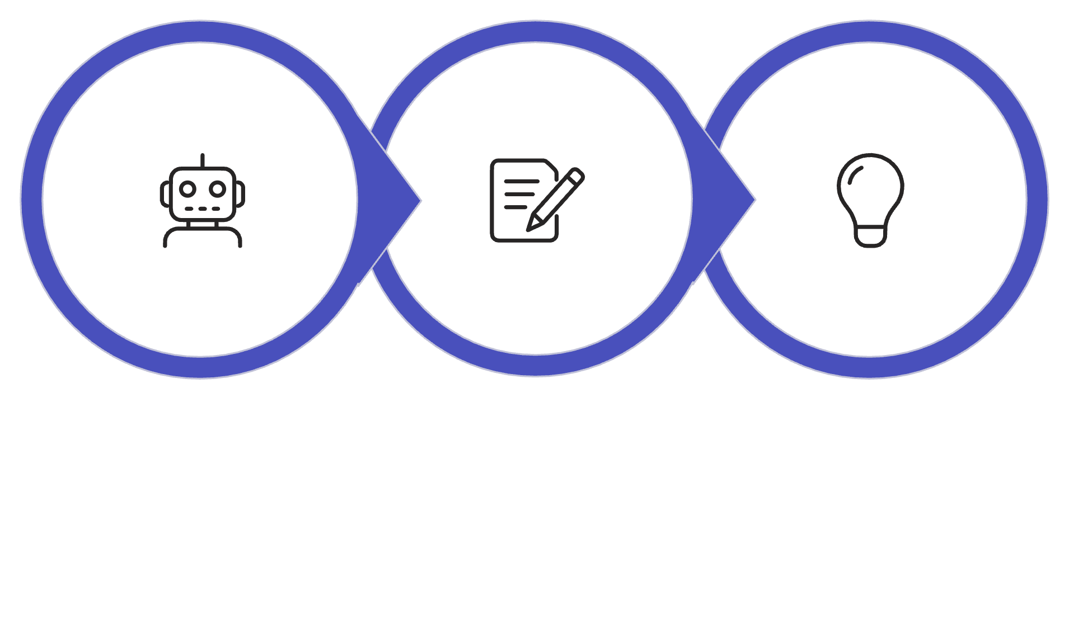
A Practical Example
Rather than prohibiting AI use, this redesigned assignment makes student thinking visible at every stage — and turns AI into a learning tool rather than a shortcut.
Critique & Revise
Reflect & Explain
Draft with AI
This structure ensures students engage analytically with AI output rather than simply submitting it. The justification and reflection steps are where the real learning, and the real assessment happen.

Slide 18

Why Redesign Matters
Without Redesign
With Redesign
AI defines the work. Students submit AI-generated outputs. Instructors lose visibility into student thinking. Assessment measures nothing meaningful. The gap between credentials and actual competency widens.
Faculty retain control over what learning looks like. Students are pushed to develop genuine skills. AI becomes a tool students learn to use critically — and institutions can confidently stand behind the learning they certify.
Intentional assignment redesign is how educators remain the architects of learning in the AI era.

Slide 19


What Comes Next
The principles and framework covered here don't have to be applied in isolation. This work is supported through a structured, practical approach — including a hands-on tool designed to guide instructors through the redesign process step by step.
Joaquin will now demonstrate how the Thering Framework comes to life in practice by walking through the tool and showing how instructors can apply these criteria to their own assignments immediately.

